Slide 1
Planning

Slide 2
What is an organization

Slide 3
Deliberate arrangement of people to accomplish some specific purpose

Slide 4
Management?

Slide 5
Process of planning organizing leading and controlling the limited resources efficiently and effectively to achieve predetermined goals and objectives in an ever changing business environment.

Slide 6
What are the management functions?

Slide 7
Planning?

Slide 8
Process of establishing goals and objectives and suitable course of action for achieving those goals.

Slide 9
Planning is broadly defined as the process of deciding how the future should be better than the present, what changes are necessary to make these improvements, and how the changes should be implemented.

Slide 10
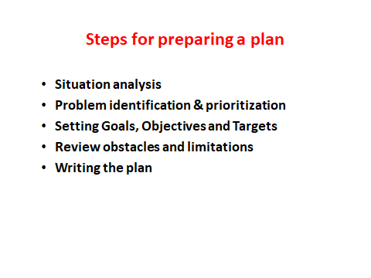

Slide 11
What is situational Analysis?
It is a methodology used to assess where we are now
It would identify existing and emerging problems and their root causes, which obstruct our achievement of expected level of performance
Identify our strengths and check whether we utilize those strengths optimally
Other external factors

Slide 12
What are the aspect should covered in SA
We need to look at
resources we have (Health service inputs)
functions and activities we perform (Outputs)
Results ( Health outcome)
In the assessment of functions and activities check the Efficiency, Effectiveness, Quality and Equity.

Slide 13
Situational analysis tools

Slide 14
Goals and objectives
Desired future state
Organization attempts to realize

Slide 15
What is a plan?

Slide 16
A document (blue print) that outlines how gals are to be accomplished. It describes how resources are to be allocated and establish activity schedules.

